Slide 1
User-Aided Encryption using Virtual Password Mechanism. Signature:________

Slide 2
1st Batch - II
Team members:
Project Guide:
Sudhasree.V
(090606112055)
Vaishnavi.G
(090606112059)
Geetha.N (M.E)

Slide 3
Abstract:
Propose - virtual password – human computing – online environments.
User-determined randomized linear functions.
Defends - phishing - key logger - shoulder surfing.
Virtual password - defend all attacks together.

Slide 4
Objective:
The objective is to design less complex but secure virtual functions.
The function should be unobservable.
The function should be insolvable.

Slide 5
Existing system:
Users - Internet, - face - kinds of attacks.
E.g., a user ID and password - stolen and misused.
The SSL/TLS – still – weak - protection - plaintext password and user ID.
Still vulnerable to attacks.

Slide 6
Proposed system:
Password - constant – easy remember.
Leads – stealing password – access - victim’s account.
Pwd – random – impossible to remember.
To confront - propose - concept of virtual password.
Virtual password – generates a dynamic password - submitted - authentication.

Slide 7
Modules:
There are 2 main modules:
User module-4 sub modules
Admin module-3 sub modules

Slide 8
User Registration:
Initially - register - details.
Avoids anonymous users.
User - select constant factor - random salt - generated.
User defined – system generated function available - registration phase.

Slide 9
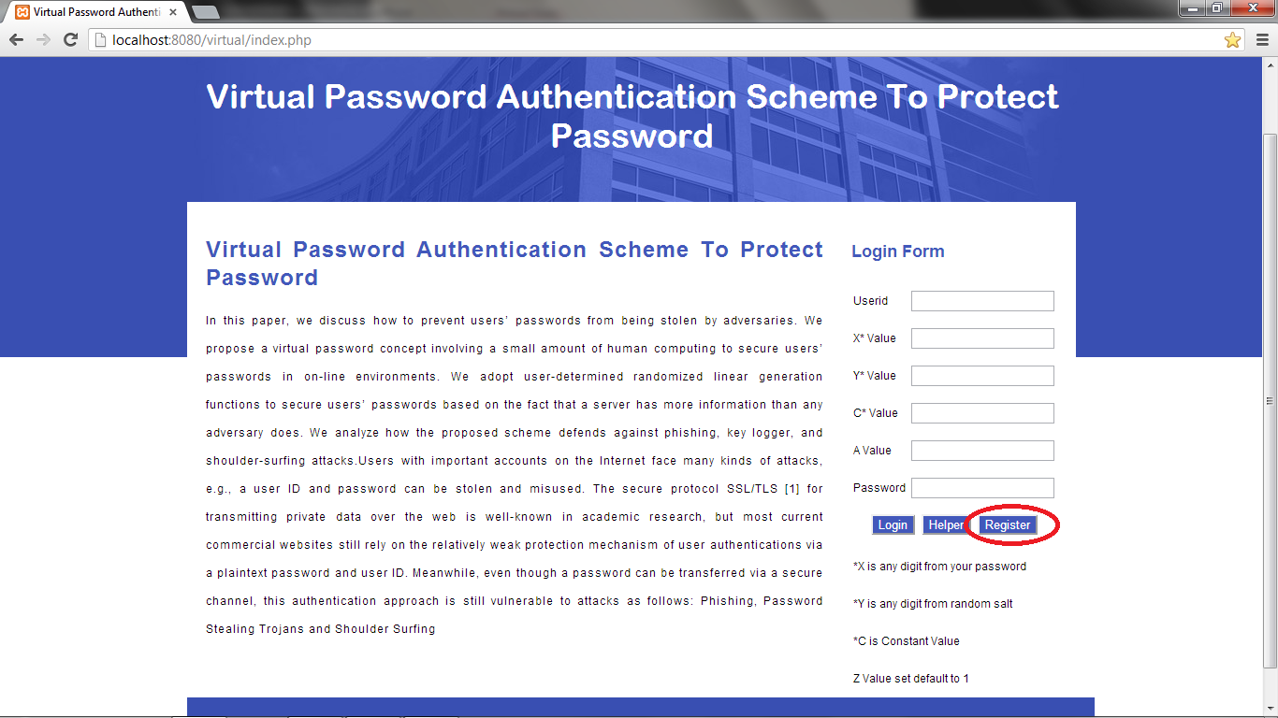
1st module output:

Slide 10
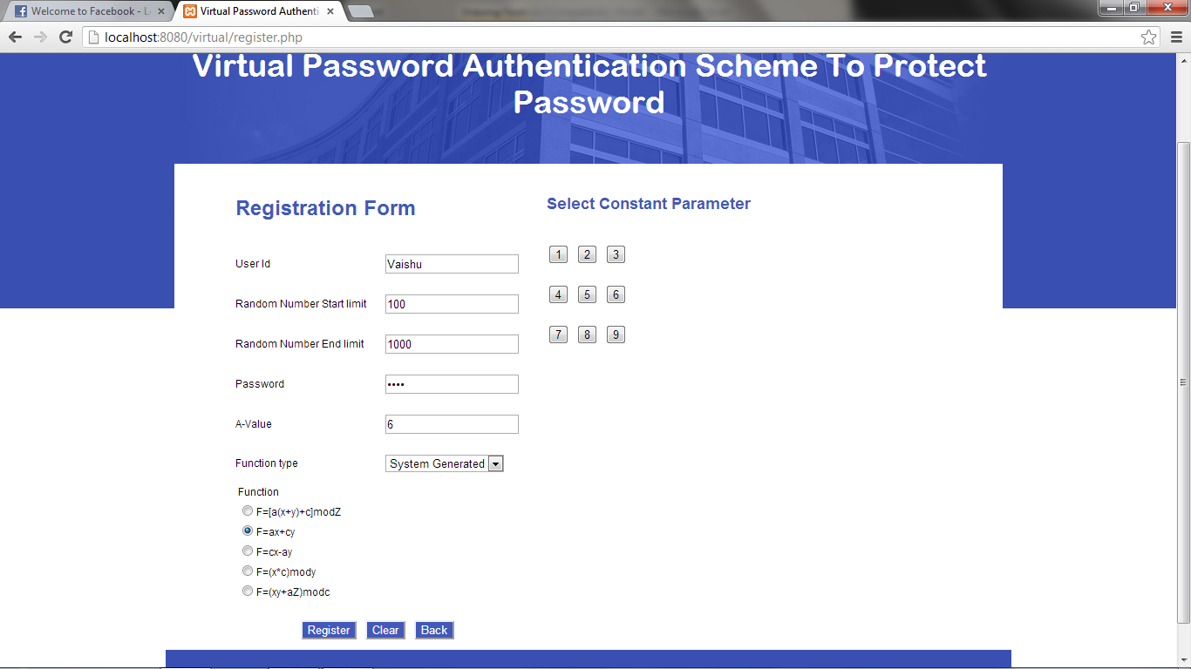

Slide 11
User login:
User select a digit from password (X).
A random digit generated (Y).
Constant value in matrix (C).
Default value (A).
Finally apply values - defined function.
System - compares value - calculated by user & system – if same - authenticate user.

Slide 12
Passport Application:
Developed - secured passport application - view passport status.
After login - register - new passport application - Captcha concept is implemented for recognizing human.

Slide 13
Admin login:
Administrator login - unique username - password.
Administrator - only authorized person - access admin module.

Slide 14
View Registered User:
Admin - view users - applied for passport.
Admin - view - user information.

Slide 15
Update Passport Status:
Admin - update - status - passport.
Admin - hold/dispatch passport - to user.
Update - date & address – passport – to deliver.

Slide 16
View Passport Status:
User – view - passport status.
Whether dispatched/under service.
If dispatched - the user can view his passport.

Slide 17
Future Enhancements:
In future - we plan - how to design smarter functions - reduces – computation.
Also develop - small applications - with virtual passwords - runs - customer’s wireless device.

Slide 18
Conclusion:
We conclude – proposed - provide security.
Also - defend against attacks.
Adopted secret little functions - enhance security - hides secret functions.
Especially – computer - insecure environment - Internet cafe.

Slide 19
Queries ?
Thanking You!!!

